Slide 1

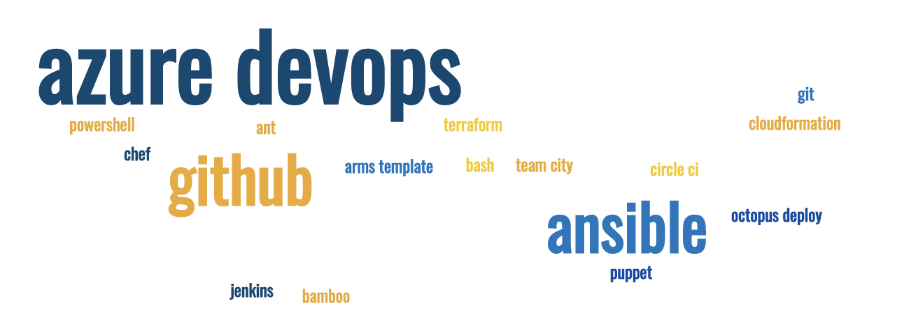
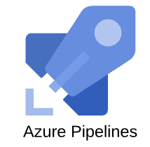
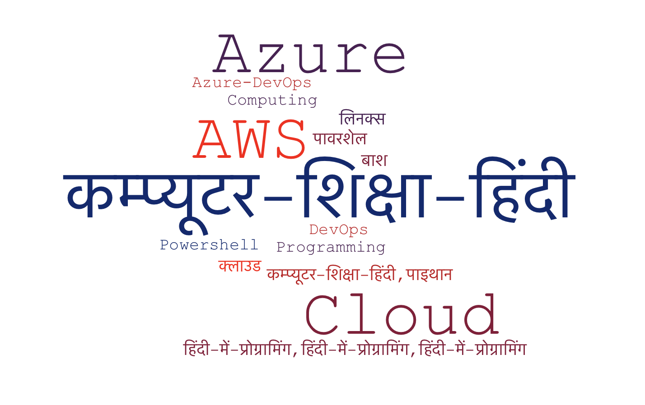
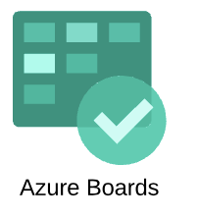
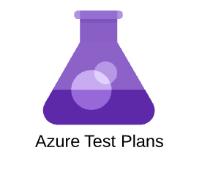
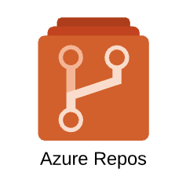
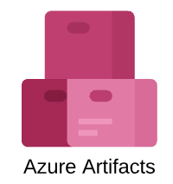
Azure – Pipelines -2
brew install --cask powershell
CI/CD – Infrastructrue deployment क्लाउड कम्प्यूटिंग के संरचना का ऑटोमेशन
Sujit Singh

Slide 2
Agenda
Azure DevOps – Pipelines
Quick Recap
CI
CI Demo
Break and quiz …
Infrastructure
Azure ARM
Template
Terrafform
PowerShell
Cli

Slide 3
Azure DevOps – recap
Free account
Azure Boards,
Azure Repos
Azure Pipeline
Azure Artifacts
Dashboards, Wiki etc
Notes:
Azure DevOps can be used free for upto 5 accounts, unlimited for ”public” projects.
Azure Boards is for the project management, or work item management
Azure Repos are version control system by using git or TFVC
Azure Pipelines is for build and deployment process (ci cd)
Azure Artifact is for package management (nugget, npm, maven etc)
Dashboards and wiki etc are for reporting and documentation.
ALM – Application Lifecycle Management– Deployment process of applications, services or websites. We have done a basic demo last Sunday. Check the link in description. Sometimes this is also refer as path to production.

Slide 4
Azure DevOps - Package
Plan
Pipelines
Monitor
DAST
Compile
Unit Test
Packaging
SAST
Security Test
Report Publish
Analysis
Transformation
Acceptance Test

Slide 5
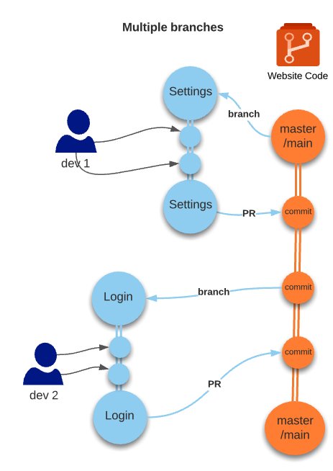
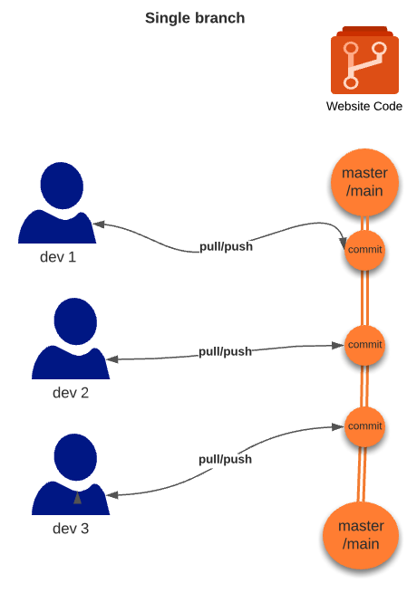
Azure DevOps - CI
Notes:
Continuous Integration
Mostly for integration of code (including infrastructure as code, scripts etc). Many people consider this integration testing of various components which is not correct/practical
Why CI Single branch can cause issue
One developer breaking the build can affect other developer
Not scalable
Multiple branch allow freedom to change in isolation
Scalable, multiple features can be worked at same time in parallel and in isolation, and can be completed when needs to
CI becomes important to put some checks and ensure that code in the ‘Protected’ branches are ‘working’ and integrity is right.

Slide 6
Demo

Slide 7
Break and quiz

Slide 8
Azure Pipelines – Infrastructure deployment
Azure
AWS
Google Cloud
Others

Slide 9
Azure Pipelines – Infrastructure deployment
Azure
ARM
Powershell
CLI
Terraform
Rest Api
SDKs

Slide 10
Questions?

